Slide 1
Data Structures Workshop

Slide 2
Clone the repository
http://bit.ly/workshop_repo

Slide 3

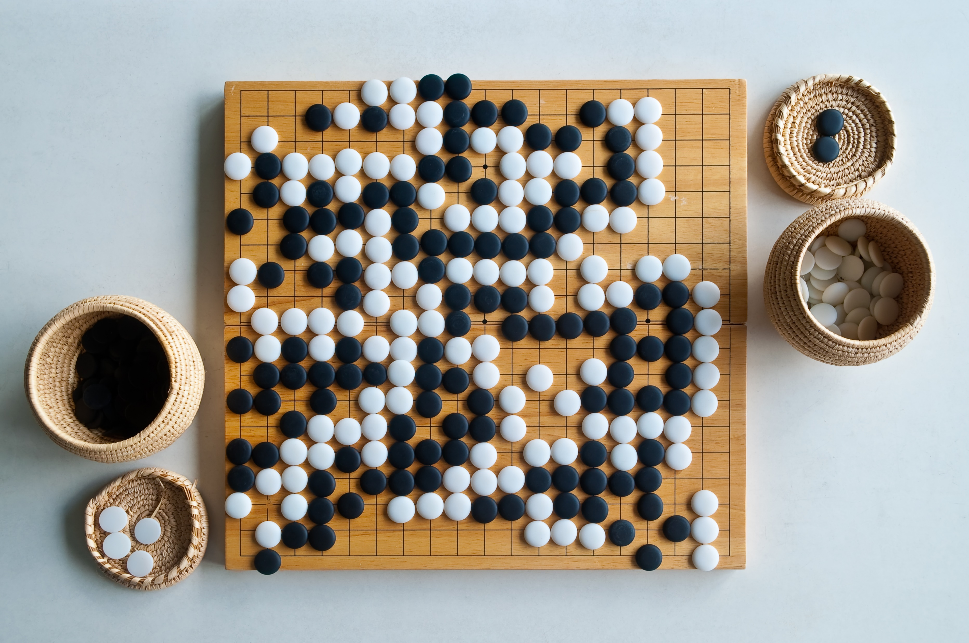

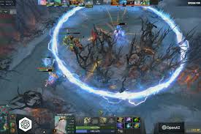
Game AI

Slide 4
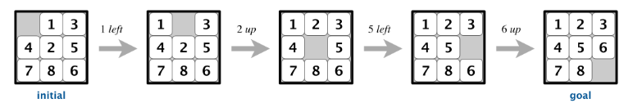
8-puzzle
https://en.wikipedia.org/wiki/15_puzzle

Slide 5
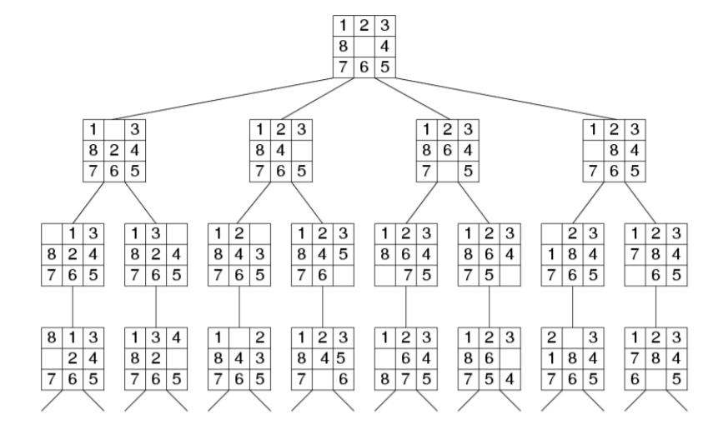
Search tree
How big is the tree
31 layers
4 294 967 296 states

Slide 6
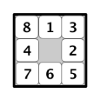
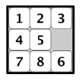
A* algorithm
Idea
If we have multiple options to explore start with more promising ones
far from goal
much closer to goal
Manhattan distance
Shows how close is our state to goal

Slide 7
A* algorithm
From all states in collection choose one with smallest manhattan distance to the goal
If the state is goal stop execution and return results
Else add all neighbors of this state to collection
Repeat until solution is found

